Slide 1
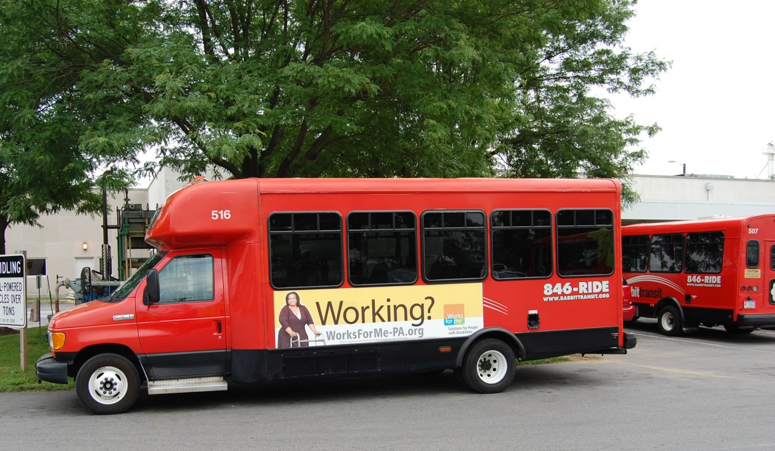

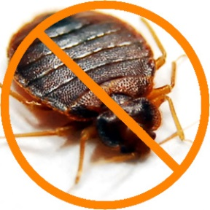
Bed Bug Eradication
Mike Devaney, COO rabbittransit
April 8th, 2015

Slide 2
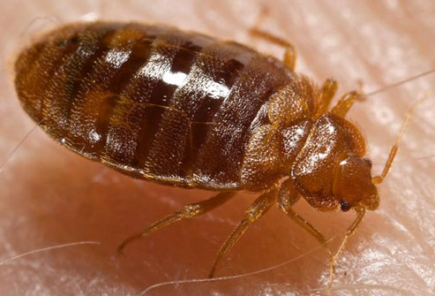
What is a bed bug?
A small, flat wingless insect with six legs.
Like a mosquito, feeds on blood from animals or humans
Grow to about 0.2 inches
They can be seen by the naked eye
Live mostly in dark crevices
Nocturnal (feed at night)

Slide 3
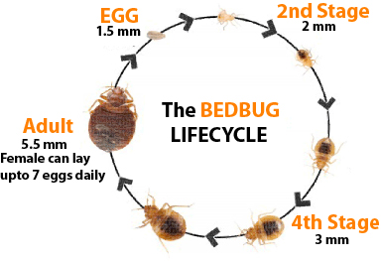
More about bed bugs

Slide 4
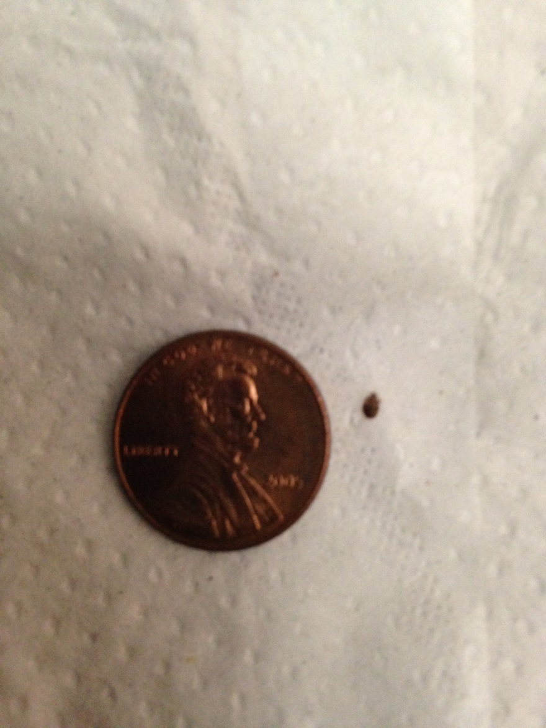
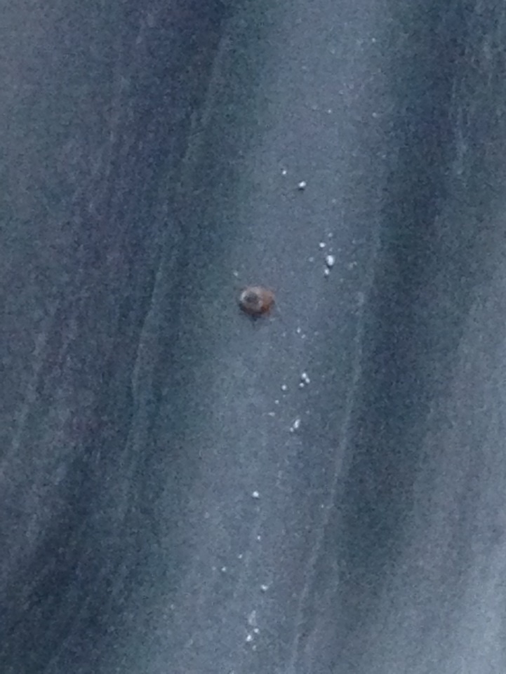
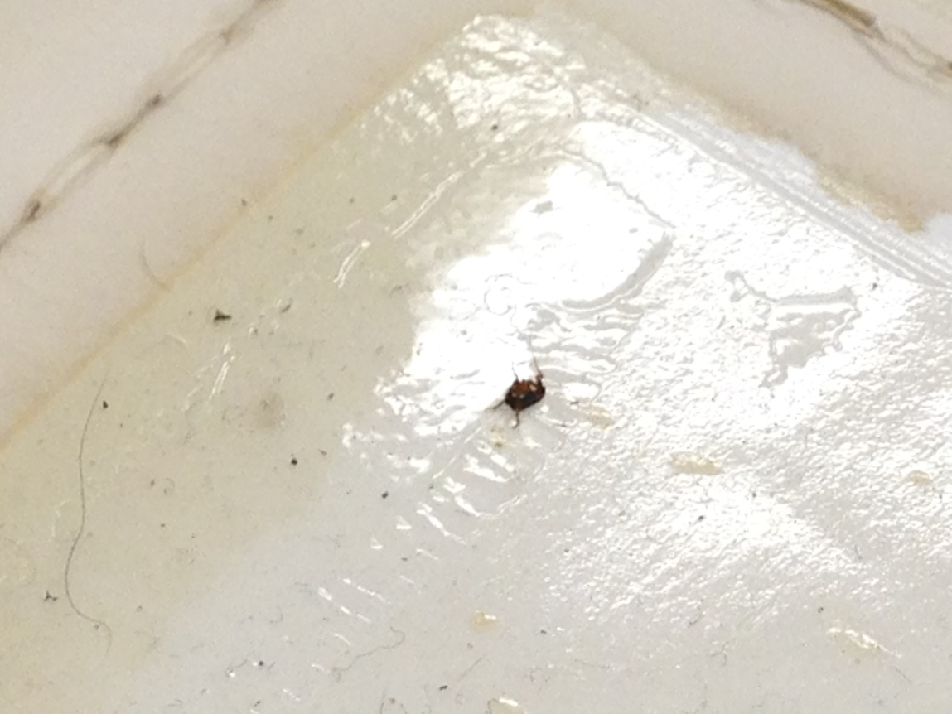
Bed Bug
FLEA

Slide 5
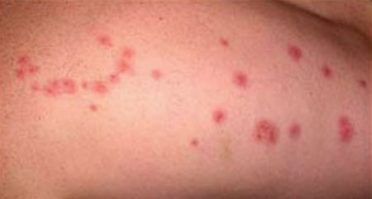
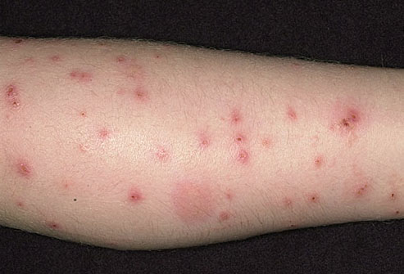
Do I have a bed bug bite, now what?
  Don’t panic! Seek out advice about bed bugs.
  If bitten, make sure the bites are from bed bugs and not fleas or other insects.
  Bed bug bites may become itchy and present instantly.
  Or a bite not appear for 14 days.
Bed bug bite
Flea bite

Slide 6
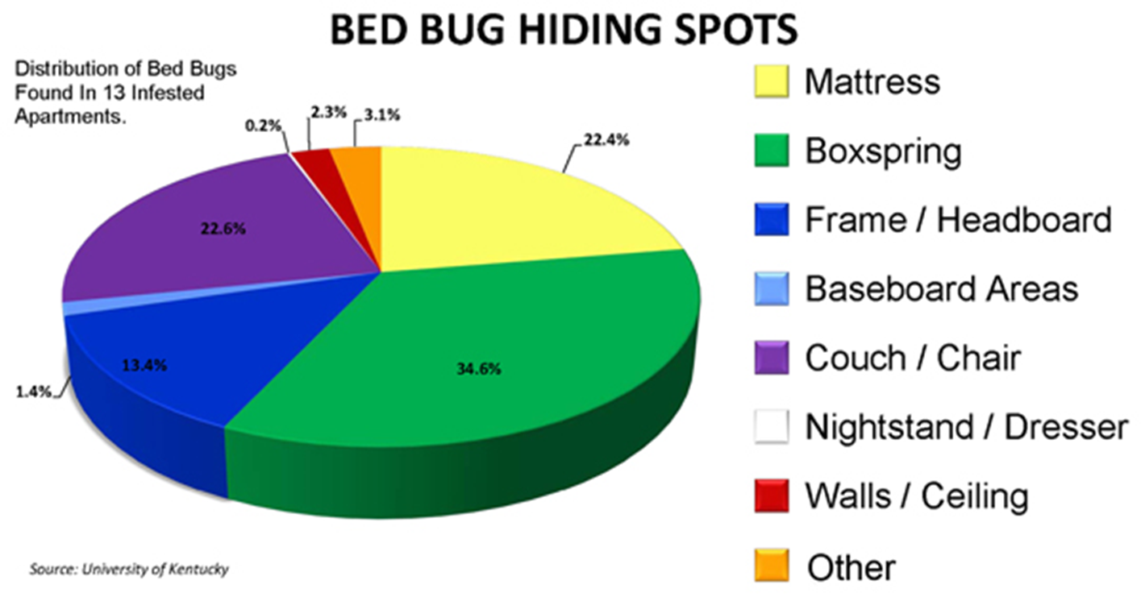
Where do they hide?

Slide 7
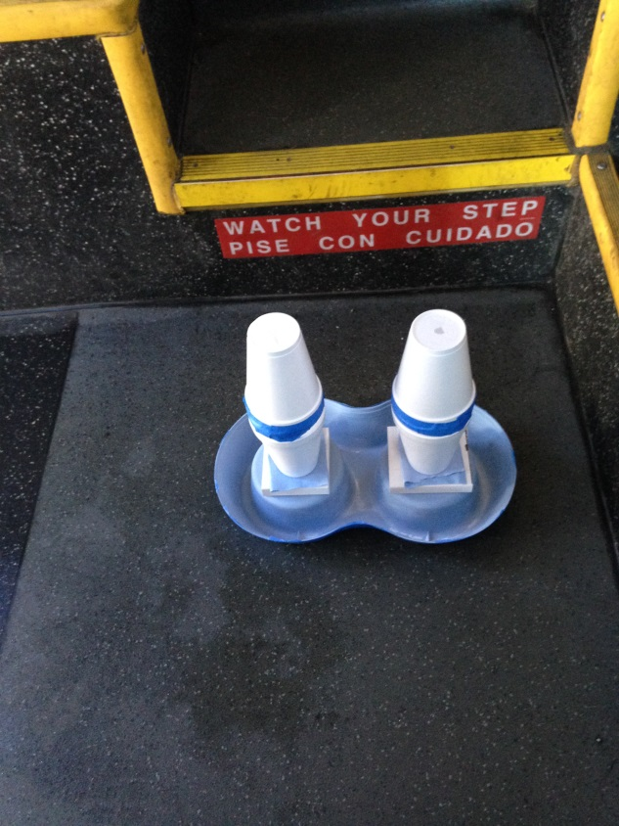
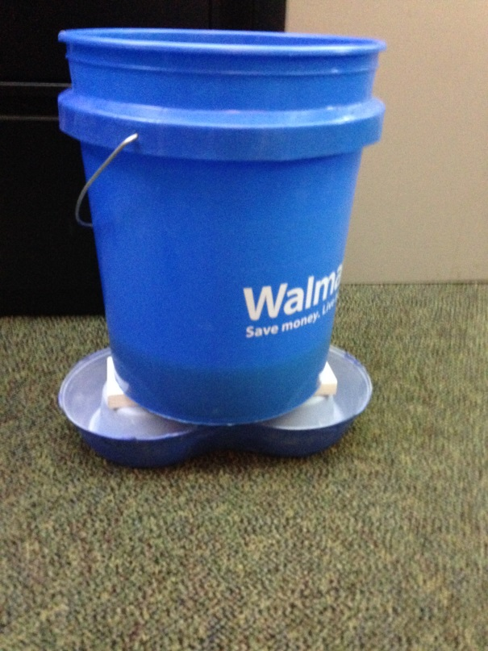
How do I know if we have bed bugs? Trap them!

Slide 8
I have bed bugs, now what?
  Again, don’t panic!
  Getting rid of bed bugs is difficult, but not impossible.
  First, get rid of the clutter. Keep a clean and tidy work space to eliminate potential hiding spots.
  Limit the amount of items you take to and from work.
  Keep personal items like handbags, briefcases, and coats off the floor.
  Be proactive and look for signs of bug activity.
  Put out a process to track any complaints.

Slide 9
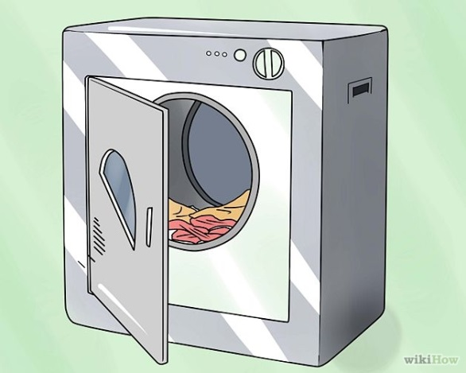
What else can I do?
Keep a spare set of clothes at work.
Change and put your clothes in a sealable plastic bag.
At home (if you don’t change at work), remove cloths before or immediately upon entering the home.
Wash cloths on the hottest temperature setting.
Dry cloths on high temperatures (120°F) for 30 minutes.

Slide 10

A rider reported a bed bug, what do we do?
  Do not ignore complaints or sightings.
  Fill out a rabbittransit Incident report.
  Note the following details:
    Date, time, and location within the bus of the bed bug incident.
    Type of complaint (bite, sighting, or other).
    Vehicle #
    Route:
    Passenger or others involved in incident.

Slide 11


rabbittransit response
Investigate each incident report.
Document treatment for every reported vehicle.
Apply heat internally to elevate temperature to a consistent 120°F for a minimum of 2 hours.
Apply isopropyl alcohol (91%) solution to the seats.
Vacuum unit as per maintenance policy and procedure.
Work with pest removal professionals.
Place traps for future monitoring.
Inspect the vehicle 1-2 weeks after treatment.

Slide 12

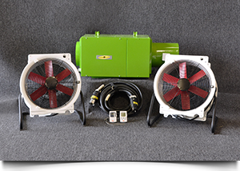


Heat kills!

Slide 13
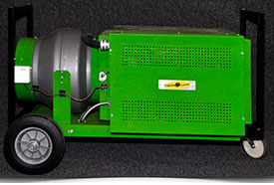
LTM20 – For Bigger Coaches

Slide 14
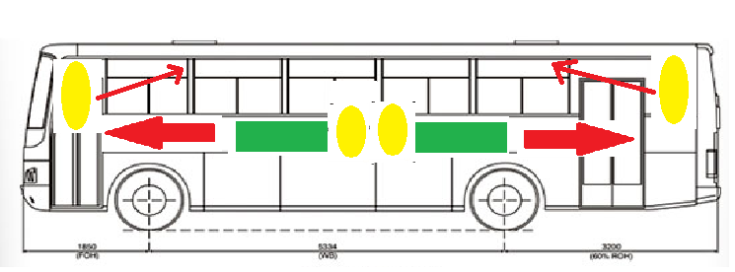
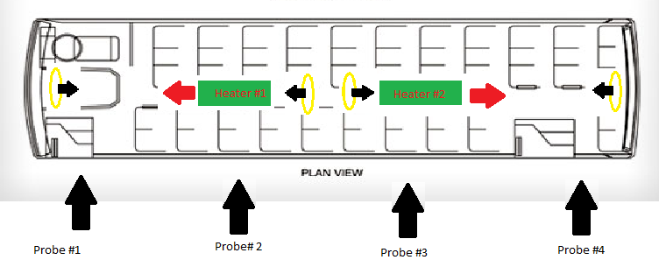

Slide 15
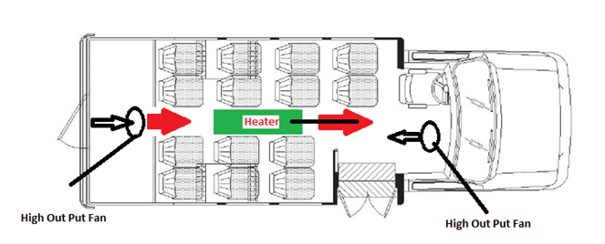
For smaller vans

Slide 16
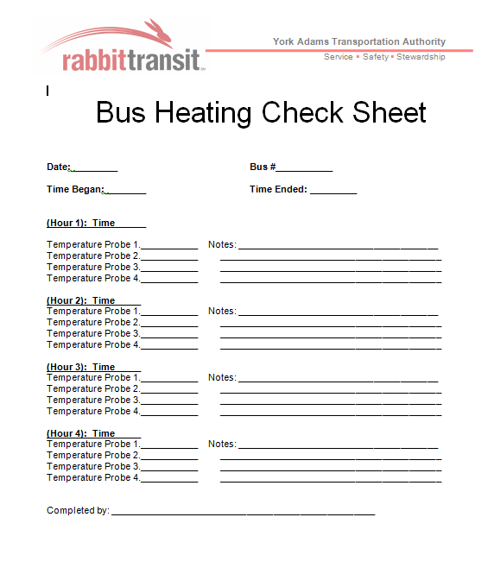
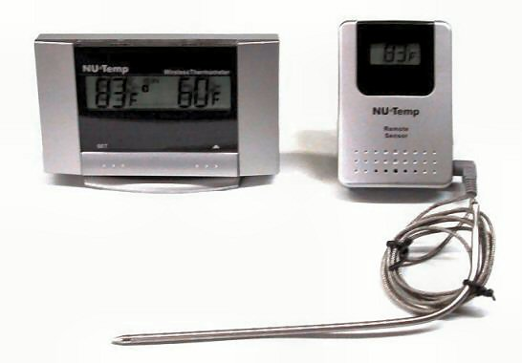
Heating and tracking!

Slide 17
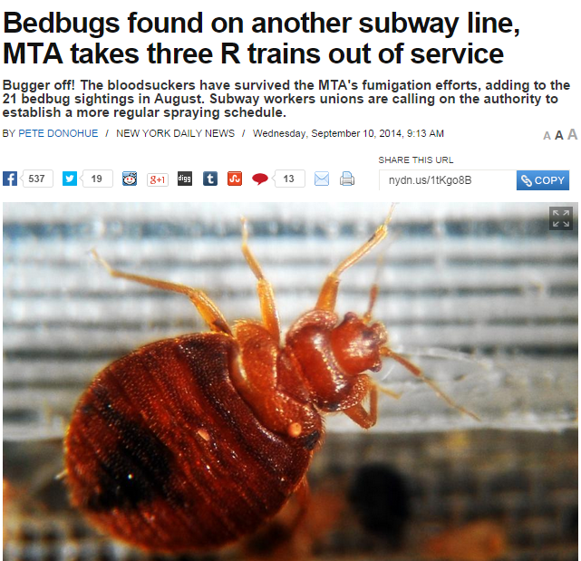
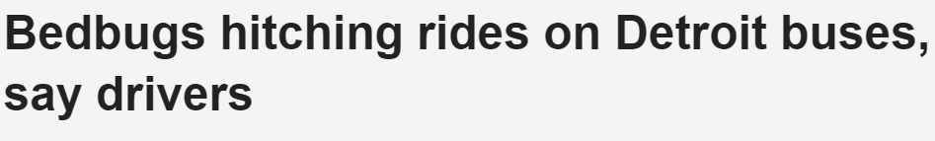
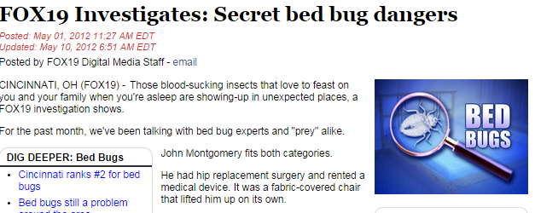
They are showing up everywhere.

Slide 18

Be Vigilant! It is a growing problem every where!

